Slide 1
No SQL data architecture patterns
Key-value stores
Graph stores
Column family stores
Document stores

Slide 2
A Key-value store is like a dictionary.
A key-value store is a simple database where data is stored as a collection of key-value pairs. Each key is a unique identifier that maps to a corresponding value, which can be any data type, such as text, binary files, or multimedia.
As an application programmer interacts with the DB with basically, the functions
Put: Adds or updates a key-value pair.
Get: Retrieves the value associated with a given key.
Delete: Removes a key-value pair.
Key-value stores are used for applications requiring fast lookups real-time analytics , trading platform-based apps.
Like the dictionary, a key-value store is also indexed by the key; the key points directly to the value, resulting in rapid retrieval, regardless of the number of items in your store.

Slide 3
Use Case: Key value-based systems
Real-Time Market Data (Stock Prices, Currency Exchange Rates)
Trading platforms need to update and retrieve real-time market data such as stock prices, commodity prices, or currency exchange rates.
The key is typically the symbol or identifier of a financial instrument, such as AAPL (for Apple stock) or USD/EUR (for the US Dollar to Euro exchange rate).
The value represents the latest price, bid/ask prices, volume, or other market metrics (e.g., {"price": 150.25, "volume": 1000}).

Slide 4
Caching Frequently Accessed Data
Websites that serve high traffic often cache commonly requested data such as product listings, user profiles, or popular content. The key could be a URL or query string, and the value could be the page content, images etc.
Web crawler utilize key-value stores for indexing web pages.
Search engines like Google use a tool called a web crawler to automatically visit a website to extract and store the content of each web page.
The crawler starts with a list of URLs to visit. It stores these URLs as keys in the key-value store, marking each URL with a status value (e.g., "pending," "visited"). This allows quick access to unvisited URLs and ensures efficient tracking of already-visited pages
To support fast search, the crawler generates an inverted index by breaking down each page’s content into keywords and storing them in the key-value store. Each keyword serves as a key, and the associated URLs or page IDs where the keyword appears become the values. This setup makes keyword-based lookup efficient and fast.

Slide 5
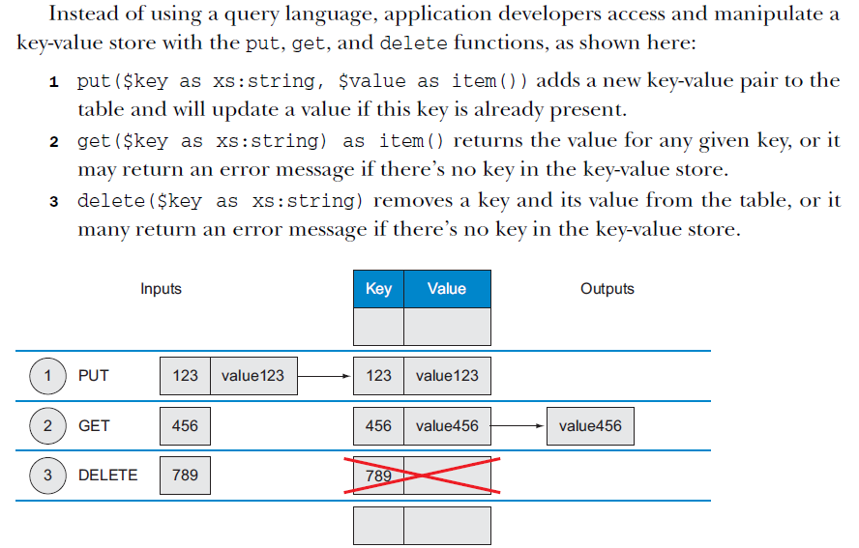

Slide 6
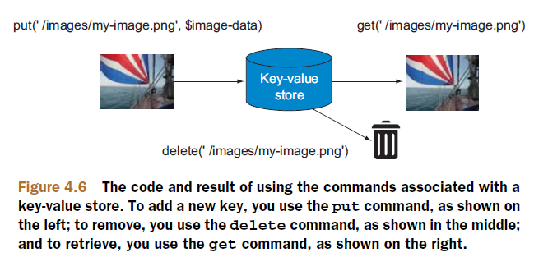

Slide 7
Four Benefits of using a key-value store
Precision service levels.
They support high-performance retrieval by allowing for constant-time complexity (O(1)) for read and write operations, which minimizes latency. This level of precision is especially advantageous for applications that require real-time responsiveness, such as online gaming or e-commerce
Precision service monitoring and notification.
Key-value stores often have built-in tools or support integrations for detailed monitoring and notifications. Many key-value databases can alert on performance thresholds or usage patterns, enabling timely responses to potential issues
Scalability and reliability.
Key-value stores are designed with scalability in mind. They typically use horizontal scaling, meaning you can add more nodes (servers) as data or load increases, without impacting performance. This structure ensures fault tolerance and redundancy, as data is distributed across multiple nodes
Portability and lower operational costs.
Key-value stores are often portable, supporting deployment across various platforms, from on-premises to cloud environments. They generally require fewer resources to operate and maintain than traditional relational databases, leading to lower operational costs

Slide 8
Key-value stores in comparison to traditional relational databases
Key-value stores offer several advantages over traditional relational databases:
Scalability: Easily scales across multiple nodes, making it suitable for distributed systems.
Simplicity: No complex schemas or relationships, reducing overhead.
High performance: Fast read and write operations due to the absence of SQL queries.
These features make key-value stores ideal for web applications, e-commerce platforms etc.

Slide 9
redis-cli in cmd // command line interface
//SET: Set the value of a key
SET mykey "Hello, Redis!"
//GET: Get the value of a key
GET mykey
//DEL: Delete a key
DEL mykey
//EXISTS: Check if a key exists.
EXISTS mykey

Slide 10
//hash in Redis is a data structure that represents a collection of key-value pairs
//key: The name of the hash you want to modify or create.
//field: The specific field within the hash you want to set.
//value: The value to assign to the specified field.
In Python, a dictionary might look like this
user = {
"name": "Alice",
"age": 30,
"email": "alice@example.com"
}
In Redis, you would represent the same data using a hash:
HSET user name "Alice"
HSET user age 30
HSET user email "alice@example.com"

Slide 11
//HGET: Get the value of a field in a hash
HGET user name
//HGETALL: Get all fields and values in a hash.
HGETALL user
// HDEL: Delete a field from a hash
HDEL user age

Slide 12
// Construct lists
// List Commands
LPUSH mylist "first"
LPUSH mylist "second"
//LRANGE: Get a range of elements from a list.
LRANGE mylist 0 -1

Slide 13
//Set Commands
//SADD: Add one or more members to a set.
SADD myset "apple"
SADD myset "banana"
//SMEMBERS: Get all members of a set
SMEMBERS myset
// SREM: Remove one or more members from a set
SREM myset "apple"

Slide 14
A Graph store is a system that contains a sequence of nodes and relationships that, when combined, create a graph.
A graph store has three data fields: nodes, relationships, and properties.
Some types of graph stores are referred to as triple stores because of their node-relationship-node structure.
RDF (Resource Description Framework)

Slide 15
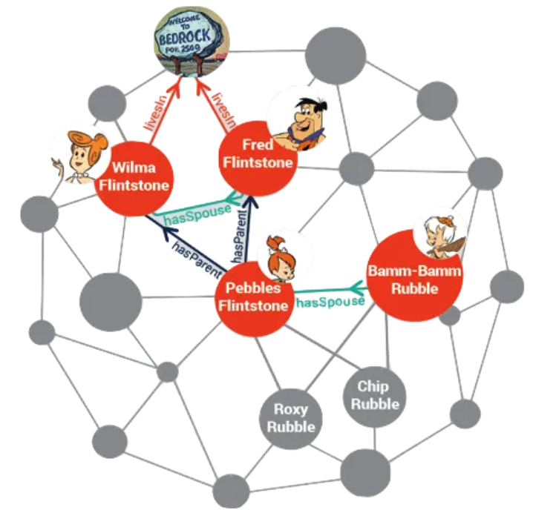
RDF (Resource Description Framework) uses triples to represent data in the form of subject-predicate-object.

Slide 16
RDF (Resource Description Framework) uses triples to represent data in the form of subject-predicate-object. This structure allows datasets to be linked and queried in a graph format.
Example of RDF Triple:
(Book, has-author, Person123)
(Person123, has-name, "Dan")
RDF enables the creation of linked data by assigning unique identifiers (URIs) to each node and linking them through predicates. This allows datasets from different sources to be joined seamlessly. RDF triples facilitate semantic search, enabling more meaningful queries and relationships between data points.
Triples as Graph Components: RDF stores data as triples (subject-predicate-object), where:
The subject represents an entity or node.
The predicate denotes the relationship (or edge) between entities.
The object is the target node or value associated with the subject. In a graph database, each RDF triple directly translates to a graph component, making it easy to visualize and traverse relationships.

Slide 17
Comparison of Graph stores and Key-value stores
Feature | Graph Stores | Key-Value Stores
Data Structure | Nodes (entities) and edges (relationships) form a graph structure | Key-value pairs without explicit relationships
Use Case | Ideal for applications requiring complex relationship analysis, such as social networks or rule-based systems | Suitable for applications needing quick lookups and high performance without complex relationships
Complex Queries | Supports complex queries like finding shortest paths, calculating connectedness etc. | Limited to basic lookups; complex queries are challenging
Relationship Handling | Link analysis. Designed to represent and analyze relationships; relationships are as important as entities. | Relationships between entities are not explicitly represented
Query Performance | Efficient for relationship-based queries | Highly efficient for simple get/set operations

Slide 18
Neo4J
Create Nodes
CREATE (p:Person {name: "Alice", age: 30})
CREATE (p:Person {name: "Bob", age: 35})
CREATE (p:Person {name: "Marry", age: 25})
CREATE (p:Person {name: "Roy", age: 30})
CREATE (p:Person {name: "Roy", age: 30})
Create Relationships:
MATCH (a:Person {name: "Alice"}), (b:Person {name: "Bob"})
CREATE (a)-[:FRIEND_OF]->(b)
Retrieve Nodes and Relationships:
MATCH (p:Person) RETURN p

Slide 19
Retrieve Nodes and Relationships:
MATCH (p:Person) RETURN p
Delete Nodes and Relationships:
MATCH (p:Person {name: "Alice"}) DETACH DELETE p
MATCH (p:Person) RETURN COUNT(p) // to count all Person nodes.
MATCH (p:Person) WHERE p.age > 25 RETURN p // to get people older than 25.
MATCH (a:Person)-[:FRIEND_OF]-(b:Person) RETURN a, b // to find mutual friends.
MATCH (a:Person)-[:Spouse_OF]-(b:Person) RETURN a, b
MATCH p = shortestPath((a:Person)-[*]-(b:Person)) RETURN p.
CREATE (p:Person {name: "Alice", age: 30}), (h:House {address: "123 Main St", price: 250000}), (p)-[:OWNS]->(h)
MATCH (p:Person {name: "Alice"})-[:OWNS]->(h:House) RETURN p, h

